Slide 1

HOW TO SAVE LIVES?
Tom Novak
Max Basov
PI Sigal Kaplan

Slide 2
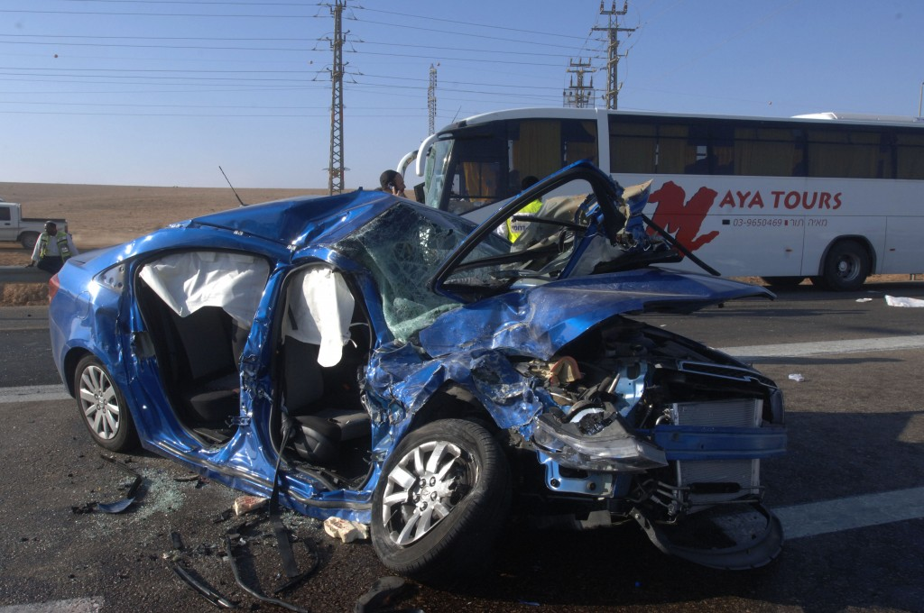

Slide 3
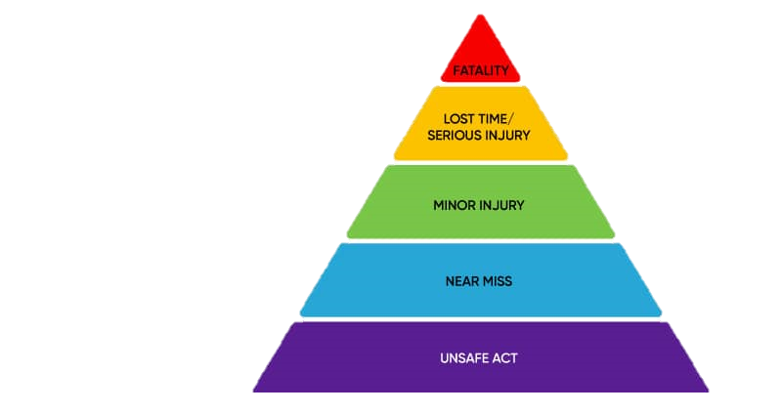
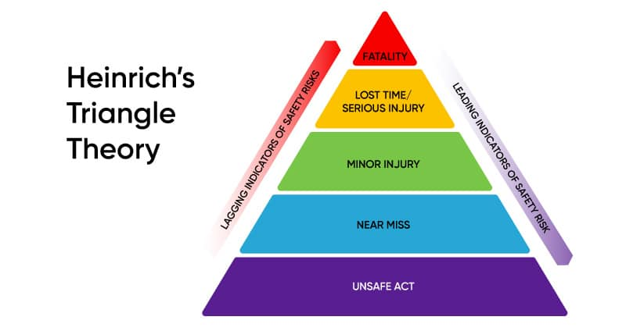
BACKGROUND
In 2021, 1.3 million people were killed in road traffic accidents around the world
Notes:
In Israel 361

Slide 4
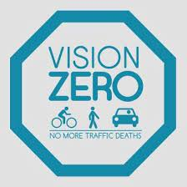
VISION ZERO
Worldwide
Multi-national road traffic safety project
Aims to eliminate all traffic fatalities and severe injuries
Started in Sweden in 1997 and spread to dozens of countries
New York City
Since 2014 1.6B$ were invested
Focus on enforcement, engineering, legislation and education
Notes:
For the first dot: "Life and health can never be exchanged for other benefits within the society”

Slide 5
RESERCH HYPOTHESIS
What is the probability for a traffic accident based on temporal and spatial analysis of infrastructure improvements and traffic law enforcement in NYC?
Benefit city engineers and transportation researchers in understanding how do enforcement and infrastructure changes effect road safety
Embedded trafic simulations
Notes:
מה ההסתברות לתאונת דרכים כתלות בשינוי תשתיתי ואכיפתי הן במימד הזמן והן במימד המרחב בעיר ניו יורק?

Slide 6
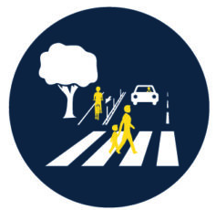
RELATED WORK
A paper from 2021 tried to predict traffic accident
In Beijing
Based on road networks, traffic accidents, taxi GPS, meteorological data and POI’s
Used deep spatial-temporal graph convolutional network
Will be used to build our framework
Le Yu, Bowen Du, Xiao Hu, Leilei Sun, Liangzhe Han, Weifeng Lv,
Deep spatio-temporal graph convolutional network for traffic accident prediction,
Neurocomputing, Volume 423,2021,Pages 135-147,ISSN 0925-2312
Notes:
We add enforcement and infrastructure changes

Slide 7
RELATED WORK
A paper from 2022 tried to examine modal fatality trends and strategy effectiveness of Vision Zero
Focused on pedestrian and bicyclist collisions in 18 cities who taken Vision Zero pledge
Executed T tests over several simple regression models
Only in NYC a statistically significant reduction in fatal collisions was observed
Nicholas N. Ferenchak, U.S. Vision Zero Cities: modal fatality trends and strategy effectiveness, Transportation Letters ,2022

Slide 8
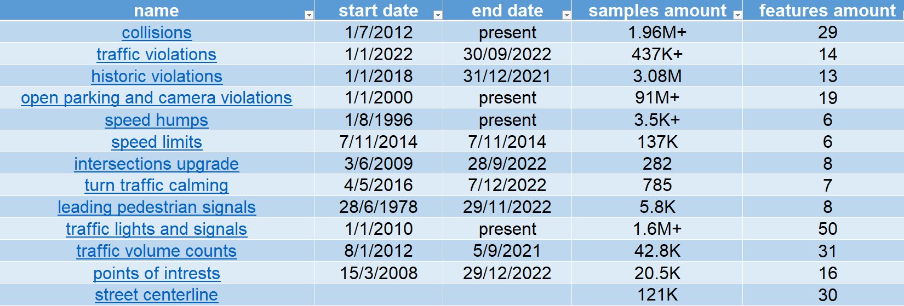
OUR DATA
NYC open data

Slide 9
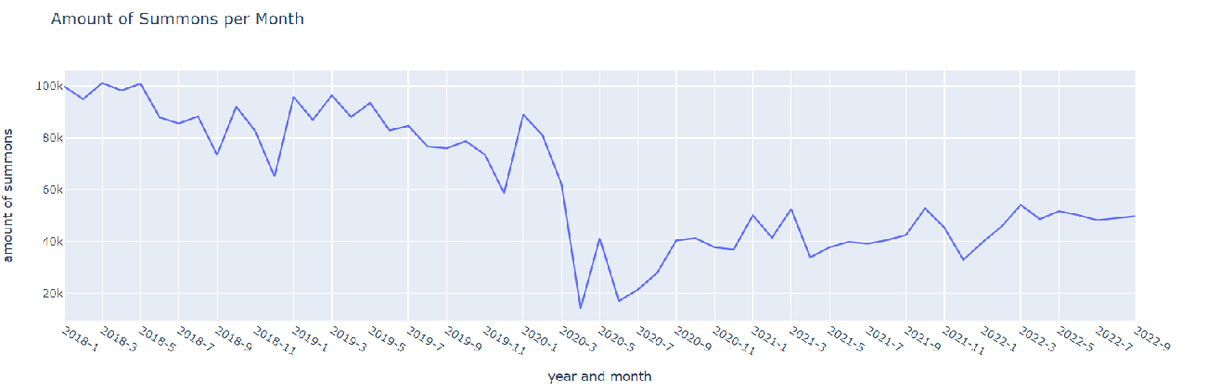
OUR DATA
amount of summons
Notes:
7:20

Slide 10
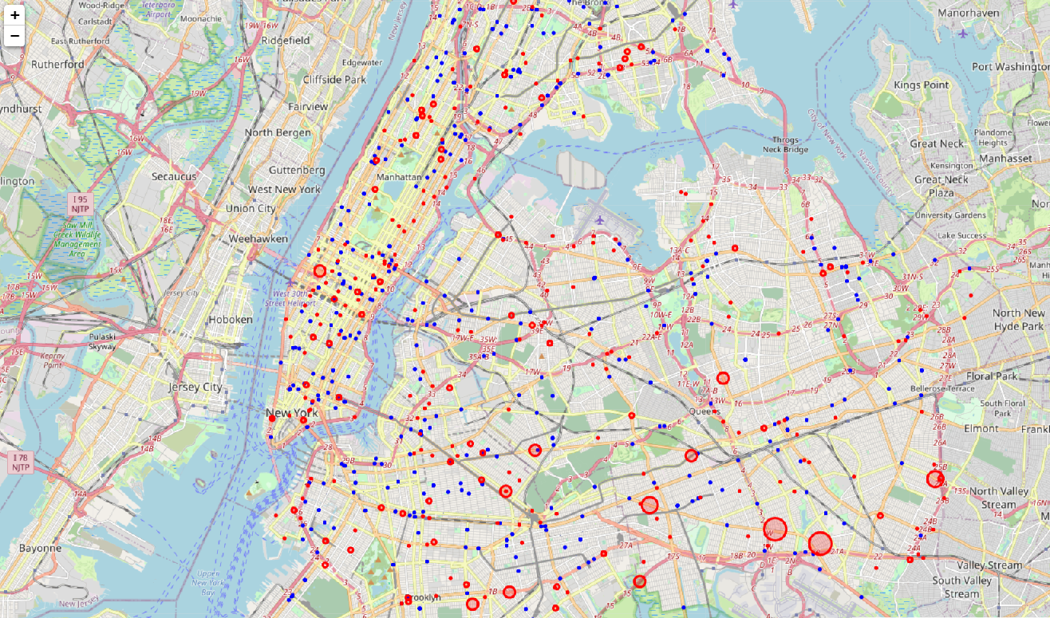
OUR DATA
New York Collisions and Summons
Collisions
Summons
Notes:
8

Slide 11
OUR APPROACH
Create a model to evaluate the effectiveness of engineering and enforcement aspects of Vision Zero program in NYC
Our Innovation:
Examine continues temporal data combined with before/after data
Examine the relation between enforcement and collisions over time
Examine multifactorial changes of infrastructure upgrades related to Vision Zero
Notes:
No data driven paper for enforcement- collisions

Slide 12
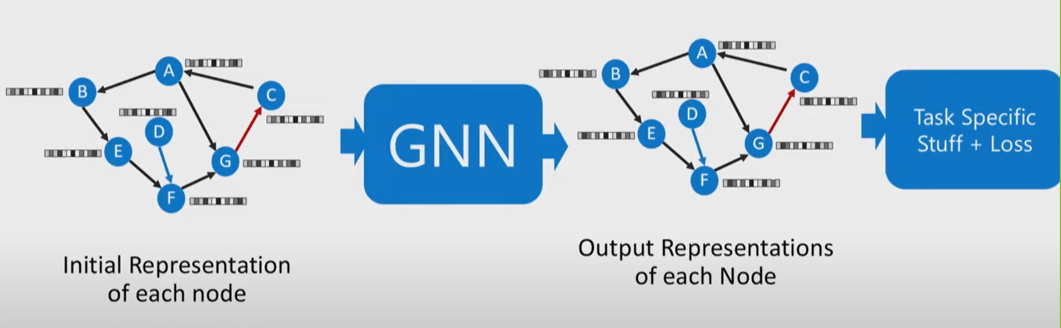
THE MODEL
We chose to use DSTGCN (deep spatial temporal graph convolutional network) as our framework
Notes:
We will add meteorological data and calendar special days.

Slide 13

OUR CHALLENGES
Deep dive into GNN – theoretically and practically
Combine large number of datasets, each with unique characteristics
Learn geographic data analysis
Severity vs. frequency, different types of violation and accidents
How to deal with data from the pandemic period?

Slide 14
QUESTIONS?

Slide 15
THANK YOU!

